Slide 1
Unit 2- Advanced cellular mobile communication systems
Multicarrier Modulation Technique
Introduction to OFDM Multicarrier Modulation Introduction
Multicarrier Modulation Cyclic Prefix, Channel model &
SNR calculation

Slide 2
Introduction to OFDM
Wireline and wireless, fixed and mobile communications or networking technologies have chosen OFDM to achieve higher data rate (what is called broadband).
Examples of such technologies are: ADSL, HomePlug AV, WiMedia UWB, Wi-Fi (802.11a/g), WiMAX.

Slide 3
Multiplexing
Capacity of transmission medium usually exceeds capacity required for transmission of a single signal
Multiplexing - carrying multiple signals on a single medium
More efficient use of transmission medium

Slide 4
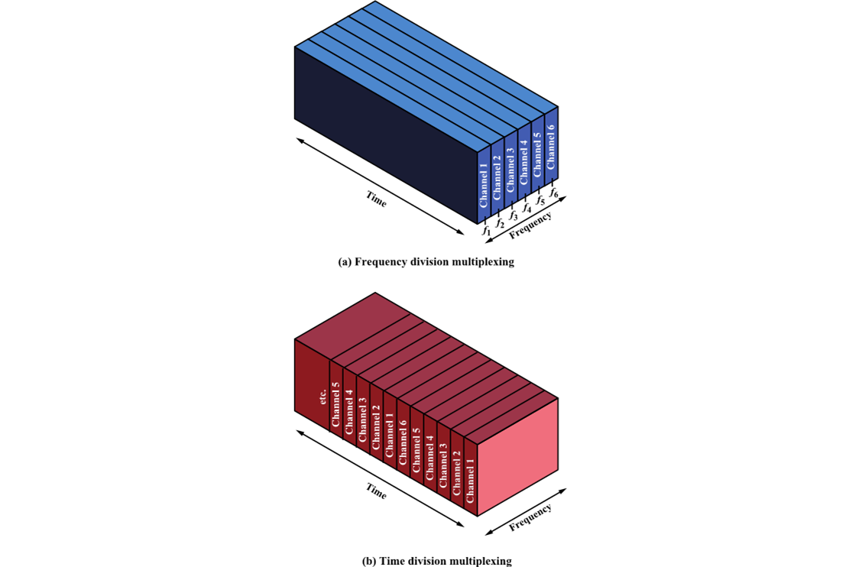
Multiplexing Techniques
Frequency-division multiplexing (FDM)
Takes advantage of the fact that the useful bandwidth of the medium exceeds the required bandwidth of a given signal
Time-division multiplexing (TDM)
Takes advantage of the fact that the achievable bit rate of the medium exceeds the required data rate of a digital signal

Slide 5
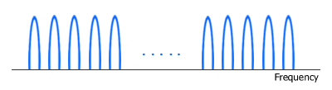
Introduction to OFDM (Contd)
WiMAX air interface is based on OFDM/OFDMA physical layer (PHY).
To understand how OFDM and OFDMA work, it is useful to start with its "mother" namely FDM (Frequency Division Multiplexing).
In FDM system, signals from multiple transmitters are transmitted simultaneously (at the same time slot) over multiple frequencies.
Each frequency range (sub-carrier) is modulated separately by different data stream and a spacing (guard band) is placed between sub-carriers to avoid signal overlap.

Slide 6
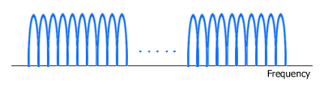
OFDM
Like FDM, OFDM also uses multiple sub-carriers but the sub-carriers are closely spaced to each other without causing interference, removing guard bands between adjacent sub-carriers.
This is possible because the frequencies (sub-carriers) are orthogonal, meaning the peak of one sub-carrier coincides with the null of an adjacent sub-carrier.

Slide 7
Features of OFDM
In an OFDM system, a very high-rate data stream is divided into multiple parallel low rate data streams.
Each smaller data stream is then mapped to individual data sub-carrier and modulated using some sort of PSK (Phase Shift Keying) or QAM (Quadrature Amplitude Modulation). i.e. BPSK, QPSK, 16-QAM, 64-QAM.
OFDM needs less bandwidth than FDM to carry the same amount of information which translates to higher spectral efficiency.
Besides a high spectral efficiency, an OFDM system such as WiMAX is more resilient in NLOS environment. It can efficiently overcome interference and frequency-selective fading caused by multipath because equalizing is done on a subset of sub-carriers instead of a single broader carrier.
The effect of ISI (Inter Symbol Interference) is suppressed by virtue of a longer symbol period of the parallel OFDM sub-carriers than a single carrier system and the use of a cyclic prefix (CP).

Slide 8
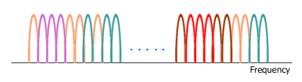
Orthogonal Frequency Division Multiple Access (OFDMA)
Like OFDM, OFDMA employs multiple closely spaced sub-carriers, but the sub-carriers are divided into groups of sub-carriers.
Each group is named a sub-channel. The sub-carriers that form a sub-channel need not be adjacent. In the downlink, a sub-channel may be intended for different receivers. In the uplink, a transmitter may be assigned one or more sub-channels.

Slide 9
Subchannelization defines sub-channels that can be allocated to subscriber stations (SSs) depending on their channel conditions and data requirements.
Using subchannelization, within the same time slot a Mobile WiMAX Base Station (BS) can allocate more transmit power to user devices (SSs) with lower SNR (Signal-to-Noise Ratio), and less power to user devices with higher SNR.
Subchannelization also enables the BS to allocate higher power to sub-channels assigned to indoor SSs resulting in better in-building coverage.

Slide 10
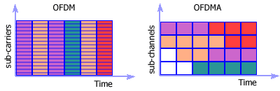
In OFDMA, several SS's can transmit at the same time slot over several sub-channels.
Subchannelization in the uplink can save a user device transmit power because it can concentrate power only on certain sub-channel(s) allocated to it.
This power-saving feature is particularly useful for battery-powered user devices, the likely case in Mobile WiMAX.

Slide 11
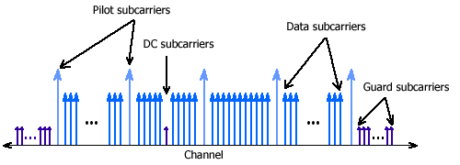
OFDM and OFDMA Symbol Structure
Both OFDM and OFDMA symbols are structured in similar way. Each symbol consists of:
- data sub-carriers (OFDM) or sub-channels (OFDMA) that carry data (information),
- pilot sub-carriers as reference frequencies and for various estimation purposes,
- DC sub-carrier as the center frequency, and
- guard sub-carriers or guard bands for keeping the space between OFDM/OFDMA signals.

Slide 12
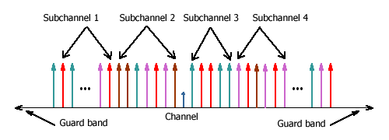
OFDMA symbol structure in WiMAX sub-carriers of the same color represent a sub-channel.

Slide 13
Scalable OFDMA (SOFDMA)
SOFDMA (S-OFDMA) adds scalability to OFDMA. It scales the FFT size to the channel bandwidth while keeping the sub-carrier frequency spacing constant across different channel bandwidths.
Smaller FFT size is given to lower bandwidth channels, while larger FFT size to wider channels. By making the sub-carrier frequency spacing constant, SOFDMA reduces system complexity of smaller channels and improves performance of wider channels.
As a reminder, IFFT (Inverse Fast Fourier Transform) is used in a WiMAX transmitter to create an OFDM waveform from modulated data streams, while FFT (Fast Fourier Transform) is used in a WiMAX receiver to demodulate the data streams. The FFT size equals the number of sub-carriers, e.g. in a OFDM/OFDMA system with 256 sub-carriers, the FFT size is 256.

Slide 14
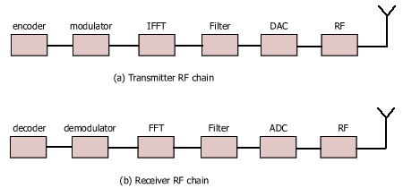
Transmitter and Receiver RF chains in WiMAX Basic building blocks of a Tx RF chain and a Rx RF chain.

Slide 15
SOFDMA is the OFDMA mode used in Mobile WiMAX. It supports channel bandwidths ranging from 1.25 MHz to 20 MHz.
With bandwidth scalability, Mobile WiMAX technology can comply with various frequency regulations worldwide and flexibly address diverse operator or ISP requirements, that's whether for providing only basic Internet service or a broadband service bundle.

Slide 16
OFDM belongs to a family of transmission schemes called multicarrier modulation, which is based on the idea of dividing a given high-bit-rate data stream into several parallel lower bit-rate streams and modulating each stream on separate carriers, often called subcarriers or tones.
Multicarrier modulation schemes eliminate or minimize inter-symbol interference (ISI) by making the symbol time large enough so that the channel-induced delays are an insignificant (typically, < 10 percent) fraction of the symbol duration.
Therefore, in high-data-rate systems in which the symbol duration is small, being inversely proportional to the data rate splitting the data stream into many parallel streams increases the symbol duration of each stream such that the delay spread is only a small fraction of the symbol duration.

Slide 17
OFDM is a spectrally efficient version of multicarrier modulation, where the subcarriers are selected such that they are all orthogonal to one another over the symbol duration, thereby avoiding the need to have non-overlapping subcarrier channels to eliminate inter-carrier interference.
In order to completely eliminate ISI, guard intervals are used between OFDM symbols. By making the guard interval larger than the expected multipath delay spread, ISI can be completely eliminated. Adding a guard interval, however, implies power wastage and a decrease in bandwidth efficiency.

Slide 18
How OFDM Works
Also called multicarrier modulation
Start with a data stream of R bps
Could be sent with bandwidth Nf_{b}
With bit duration 1/R
OFDM splits into N parallel data streams
Called subcarriers
Each with bandwidth f_{b}
And data rate R/N (bit time N/R

Slide 19
Conceptual Understanding of Orthogonal Frequency Division Multiplexing

Slide 20
Orthogonality
The spacing of the f_{b} frequencies allows tight packing of signals
Actually with overlap between the signals
Signals at spacing of f_{b} ,2f_{b}, 3f_{b} ,etc.
The choice of f_{b} is related to the bit rate to make the signals orthogonal
Average over bit time of s₁(t) × s₂(t) = 0
Receiver is able to extract only the s₁(t) signal
If there is no corruption in the frequency spacing
NOTE – Traditional FDM makes signals completely avoid frequency overlap
OFDM allows overlap which greatly increases capacity

Slide 21
Illustration of Orthogonality of OFDM

Slide 22
Orthogonality Concepts
Given an OFDM subcarrier bit time of T
f_{b} must be a multiple of 1/T
Recall f_{b} is the frequency of one OFDM subcarrier
Example: IEEE 802.11n WLAN
20 MHz total bandwidth
Only 15 MHz can be used
48 subcarriers
f_{b} = 0.3125 MHz (= N/B = 15/48 in this example)
Signal is translated to 2.4 GHz or 5 GHz bands

Slide 23
Benefits of OFDM
Frequency selective fading only affects some subcarriers
Can easily be handled with a forward error-correcting code
More importantly, OFDM overcomes intersymbol interference (ISI)
ISI is a caused by multipath signals arriving in later bits
OFDM bit times are much, much longer (by a factor of N)
ISI is dramatically reduced
Design aside: N is chosen so the root-mean-square delay spread is significantly smaller than the OFDM bit time
It may not be necessary to deploy equalizers to overcome ISI
Eliminates the use of these complex and expensive devices!!!

Slide 24
OFDM Implementation
Inverse Fast Fourier Transform (IFFT)
The OFDM concept would use N oscillators for N different subcarrier frequencies
Expensive for transmitter and receiver
Discrete Fourier Transform (DFT) processes digital signals
If N is a power of two, the computational speed dramatically improves by using the fast version of the DFT (FFT)
Transmitter takes a symbol from each subcarrier
Makes an OFDM symbol
Uses the Inverse FFT to compute the data stream to be transmitted
OFDM symbol provides the weights for each subcarrier
Then it is sent on the carrier using only one oscillator

Slide 25
IFFT OFDM Implementation

Slide 26
Cyclic Prefix
OFDM’s long bit times eliminate most of the ISI
OFDM also uses a cyclic prefix (CP) to overcome the residual ISI
Adds additional time to the OFDM symbol before the real data is sent
Called the guard interval
ISI diminishes before the data starts
Design Aside: Data from the end of the OFDM symbol is used as the CP
Simplifies the computations

Slide 28
Issues of OFDM
Peak-to-average power ratio (PAPR)
For OFDM signals, this ratio is much higher than for single-carrier signals
OFDM signal is a sum of many subcarrier signals
Total can be very high or very low
Power amplifiers need to amplify all amplitudes equally
Should have a linear characteristic with slope K on a V_{out} vs. V_{in} curve
Yet practical amplifiers have limited linear ranges
Causing distortion if outside the linear range

Slide 29
Solutions
Could reduce the peak amplitude
Called input backoff
But this would increase the signal to interference plus noise ratio (SINR)
Noise and interference would be relatively stronger because signal is weaker
Specific PAPR reduction techniques can be used
Specialized coding, phase adjustments, clipping, etc.
Single-carrier FDMA (SC-FDMA)

Slide 30
Intercarrier Interference (ICI)
OFDM frequencies are spaced very precisely
Channel impairments can corrupt this
Cyclic prefix helps reduce ICI
But CP time should be limited so as to improve spectral efficiency
A certain level of ICI may be tolerated to have smaller CPs
Doppler spread, mismatched oscillators, or even one subcarrier can cause ICI
Spacing between subcarriers may need to be increased
Could also use different pulse shapes, self-interference cancellation, or frequency domain equalizers

Slide 31
OFDMA
Orthogonal Frequency Division Multiple Access (OFDMA) uses OFDM to share the wireless channel
Different users can have different slices of time and different groups of subcarriers
Subcarriers are allocated in groups
Called subchannels or resource blocks
Too much computation to allocate every subcarrier separately
Subchannel allocation
Adjacent subcarriers – similar SINR
Must measure to find the best subchannel
Regularly spaced subcarriers – diverse SINR
Randomly space subcarriers – diverse SINR and reduced adjacent-cell interference

Slide 32
OFDM and OFDMA

Slide 33
Single-carrier FDMA
SC-FDMA has similar structure and performance to OFDMA
But lower PAPR
Mobile user benefits – battery life, power efficiency, lower cost
Good for uplinks
Uses extra DFT operation and frequency equalization compared to OFDM
DFT prior to IFFT
Spreads data symbols over all subcarriers
Every data symbol is carried by every subcarrier
Multiple access is not possible
At one time, all subcarriers must be dedicated to one user
Multiple access is provided by using different time slots

Slide 34
Simplified Block Diagram of OFDMA and SC-FDMA

